Slide 1
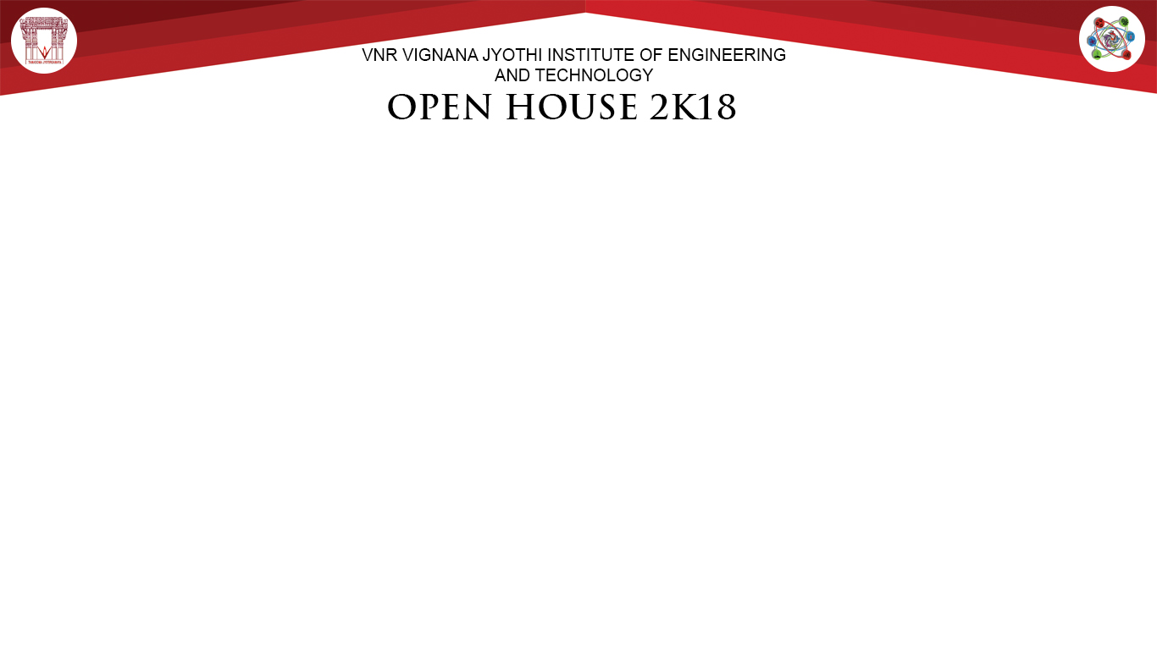
A charan reddy
B manoj Kumar
N venugopal
CSE
MEDIAR
Abstract:
Day by day the medical facilities are improving along with new diseases. which results in development of new drugs daily into the market which has different uses at different situations. The small change in the dosage misunderstanding leads to lose of life's. So give general idea to every Doctors/patients/pharma companies/illiterate person/Blind people to recognize what medicine to be taken in which quantity by simply scanning the drug using the camera of any smartphone.
Authors names
RAL Tier1
Methodology
The most advanced technology AR(augmented reality) is used to resolve this problem. By using drugs labels as the image targets as the input source, A detailed pop of the drug which contains purpose, usage & quantity is augmented as output.
For this purpose we are going to use unity 3D editor with Vuforia support
Basically we are going to have the database which contains image targets as the label of drug’s & the content related to each of the label Which describes the quantity & purpose of drug.
In the case of blind & illiterate people the voice-over in different regional languages is provided.
Results
This project help’s in giving guidance & description to the people who are in emergency/ need of information for drug usage
Conclusions
By having such features which helps to everyone to have a basic knowledge of all the essential drugs related to various diseases.
Acknowledgements:

